Slide 1
Graph Databases Continued..

Slide 2
Relational Databases
Relational databases doesn’t store “relations”
Name Relational Databases – Relational Algebra – Set theory
Well suited for structured data
Schema changes are very rare
Often normalized to eliminate redundancy

Slide 3
Graph Databases
Well suited when
Unstructured data
Schema changes are too often
Schema design is simple – What You Think is What You Design
However, One Size doesn’t fit all
When to go for Graph Databases?

Slide 4
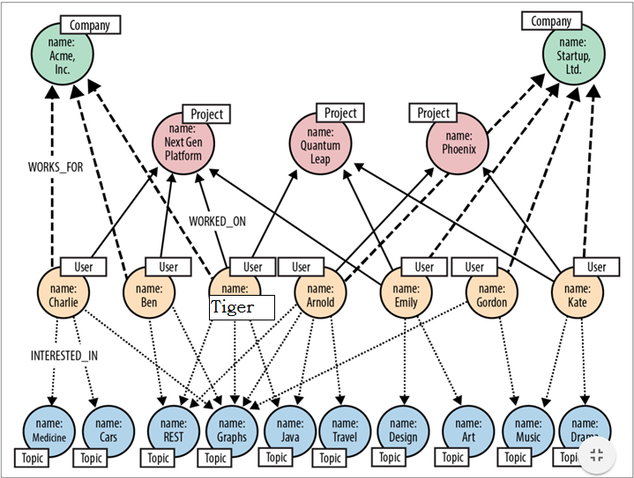
Use case – Infer Social Relationships
Source: O’REILLY Graph Databases – Ian Robinson, Jim Webber & Emil Eifrem

Slide 5
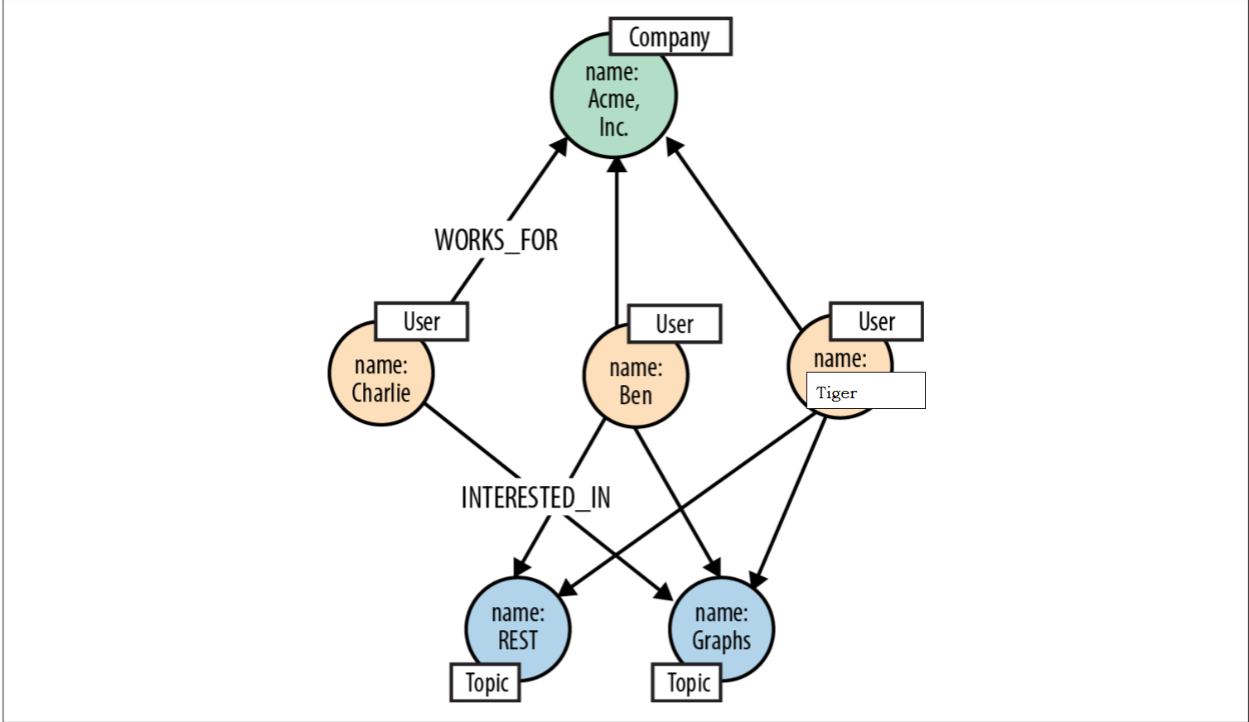
Persons with similar Interests – Same Company
Source: O’REILLY Graph Databases – Ian Robinson, Jim Webber & Emil Eifrem

Slide 6
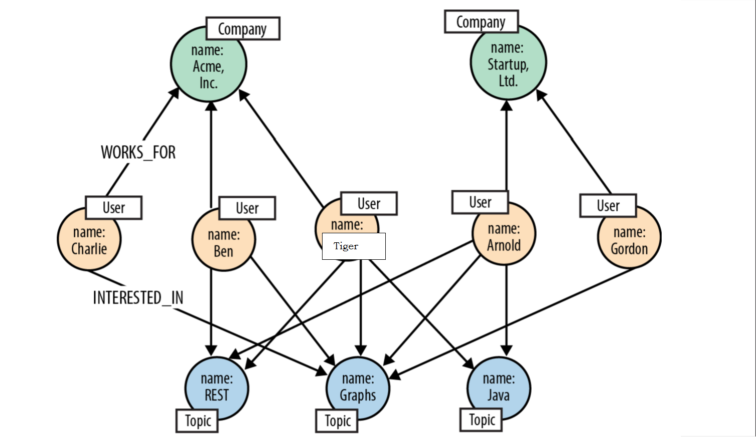
Persons with Similar Interests – In general
Source: O’REILLY Graph Databases – Ian Robinson, Jim Webber & Emil Eifrem

